Slide 1
TSM
TSM CONSULTZ
Honeywell Automation Pilot
Built and verified against a live, automated test run today — not a mockup.
Latorrey Whitehead
Founder & Chief Architect, TSM Consultz LLC · Phoenix, AZ

Slide 2



Who I Am
Founder & Solo Developer
Built and maintain TSM Consultz LLC's AI-powered enterprise platform end-to-end — architecture, backend, frontend, and deployment.
Live Production Platform
Deployed at app.tsmatter.com on Fly.io, spanning 15+ business verticals in active use — including the Honeywell vertical this deck is built on.
Applied Automation Background
Arizona insurance license (NPN 18818059) and AHIP Medicare Sales certification — domain grounding in regulated, process-heavy industries.
TSM Neural Core — Honeywell Automation Pilot
2

Slide 3

What I Ran Today
test-honeywell-pilot.js · Playwright, headless — executed live against the running server, minutes before this conversation.
1
Navigated to the Honeywell Strategist Portal
2
Randomly selected an incident source — the script picked CYBER on its own
3
Injected the cyber sample payload and reloaded the page
4
Escalated the case to the Executive Portal
5
Verified Executive Portal mount and case-queue synchronization
6
HITL gate hydrated 3 prior Honeywell decisions from persistence
Result: PASS — case created, escalated, and synchronized across pages against the live server.
The same server instance also carries persisted decision history for five other verticals (Healthcare, BPO, Mortgage, PM) — this is a running platform, not a demo built for this meeting.
TSM Neural Core — Honeywell Automation Pilot
3

Slide 4

TALK TRACK
Say this out loud between the proof and the scenarios
“
That run just proved the pipeline works end to end. But the real question isn't whether it can run a test case — it's whether it catches the kind of trouble that actually costs you money, downtime, or safety exposure.
The same architecture you just watched pass handles three very different kinds of incident. Today's run happened to draw ‘cyber’ — but plant incidents and supplier shutdowns run through the exact same discipline: detect early, score the exposure, put a human in the loop before it becomes a bigger problem.
Let me show you what each one actually looks like.
TSM Neural Core — Honeywell Automation Pilot
4

Slide 5

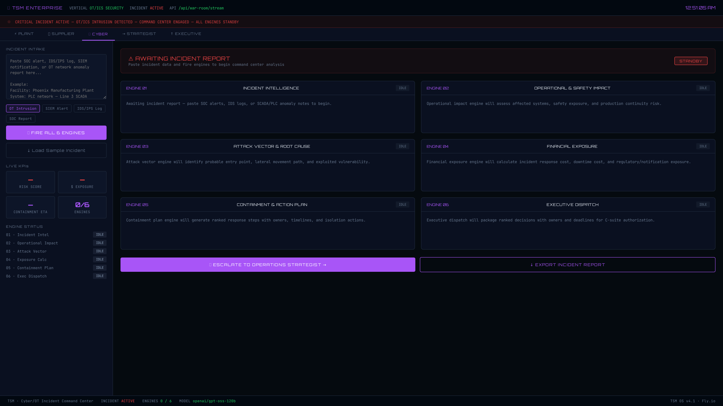
SCENARIO 1 OF 3
Cyber Incident
2 AM. The plant historian starts throwing anomalous write patterns — the early signature of ransomware trying to get a foothold before the day shift wakes up to catch it.
TALK TRACK
“The Strategist scores the exposure and builds the case before a human ever touches a keyboard.”
Live: Cyber / OT Security Incident Command Center
TSM Neural Core — Honeywell Automation Pilot
5

Slide 6

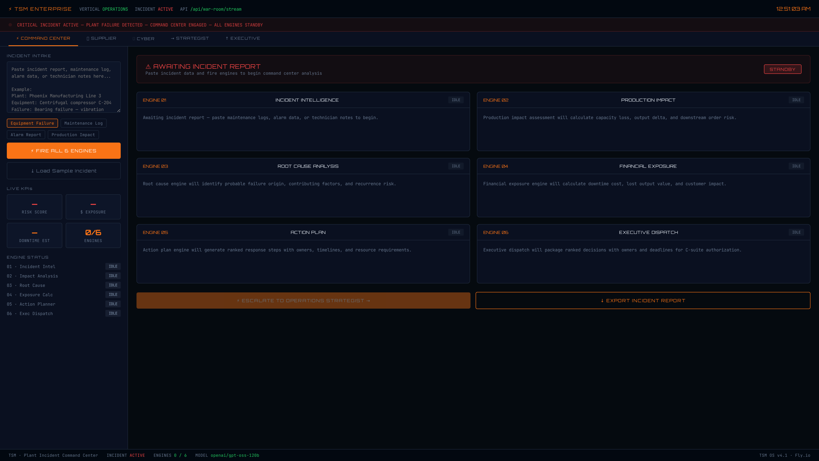
SCENARIO 2 OF 3
Plant Incident
A critical valve starts showing a temperature spike that doesn't match its maintenance history — the kind of anomaly that either burns out quiet or turns into an unplanned line-down event.
TALK TRACK
“Same exposure engine, same escalation logic as cyber — the pattern underneath is identical.”
Live: Plant Incident Command Center
TSM Neural Core — Honeywell Automation Pilot
6

Slide 7

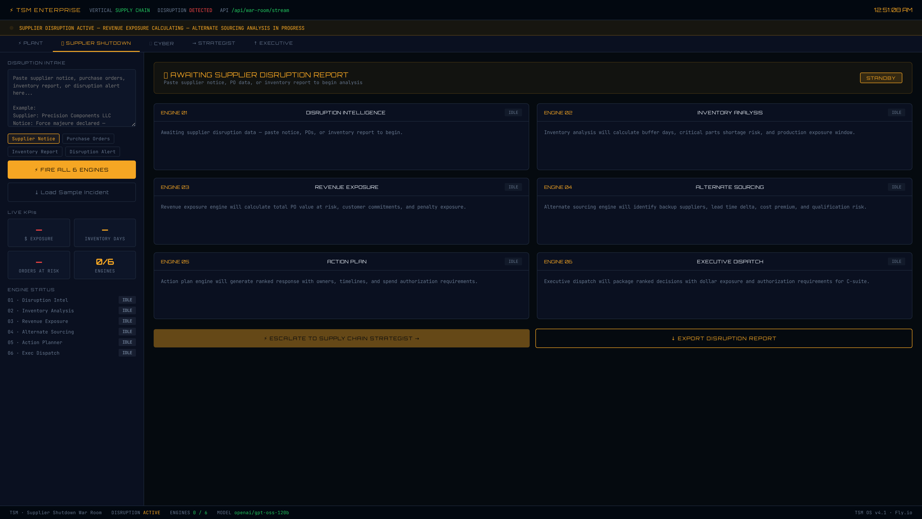
SCENARIO 3 OF 3
Supplier Shutdown
A key supplier for a critical component just had a fire at their facility. Not a technical anomaly — a business one — but it hits the plant just as hard if lead times blow out.
TALK TRACK
“Strategist, Executive Portal, Audit layer — the same three-page decision, every time.”
Live: Supplier Shutdown War Room
TSM Neural Core — Honeywell Automation Pilot
7

Slide 8
Under the Hood
The automation stack every Honeywell case runs through — checkmarks show what today's test exercised directly.
Relay Control Plane
Mission Runtime
Shared event bus routing case data across pages in real time
Model + store layer tracking each case's lifecycle end to end
Verified today
Verified today
BNCA Exposure Engine
HITL Gate
Computes business/financial exposure scoring per incident
Human-in-the-loop checkpoint before high-stakes actions execute
Verified today
Case & Delivery Manager
Audit / Governance Engine
Persists case state and packages the final decision record
Logs every decision for compliance and after-action review
Verified today
TSM Neural Core — Honeywell Automation Pilot
8

Slide 9
Honeywell Sits Inside a Larger System
This isn't a one-off demo — it's one vertical on a platform built to the same pattern 15+ times over.
15+
PROBLEM
INPUT
ANALYZE
DECIDE
EXECUTE
REPORT
MEASURE
Same operating system — sector-specific workflow layered on top (Healthcare, Construction, Mortgage, Insurance, Legal, BPO, and Honeywell).
business verticals live on one platform
Every vertical follows the same consistent triad:
War Room / Strategist
Executive Portal
Audit & Delivery Layer
Where a case gets analyzed
Where a decision gets made
Where the outcome gets recorded
TSM Neural Core — Honeywell Automation Pilot
9

Slide 10



What This Demonstrates
Skills that map directly onto an entry-level Industrial Automation role — each one grounded in today's live run, not a claim.
Process Automation Design
Test Automation
Modeled a real incident-response workflow (cyber / plant / supplier) as a repeatable, staged automation.
Built and ran a headless Playwright test that drove the app exactly as a user would, end to end, against the live server today.
Human-in-the-Loop Governance
Systems Thinking at Scale
Designed decision gates so automation assists a human decision-maker rather than replacing oversight.
Applied one architecture pattern consistently across 15+ verticals instead of one-off scripts.
TSM Neural Core — Honeywell Automation Pilot
10

Slide 11
What I'm Asking For
An entry-level opportunity on Honeywell's Industrial Automation team — to bring this hands-on build-and-test experience in-house and grow with the team.
I'd welcome the chance to walk through the live Strategist and Executive Portal pages together, or run the automated test live.
Latorrey Whitehead
Founder & Chief Architect, TSM Consultz LLC · Phoenix, AZ
app.tsmatter.com
TSM Neural Core — Honeywell Automation Pilot
11

